Slide 1

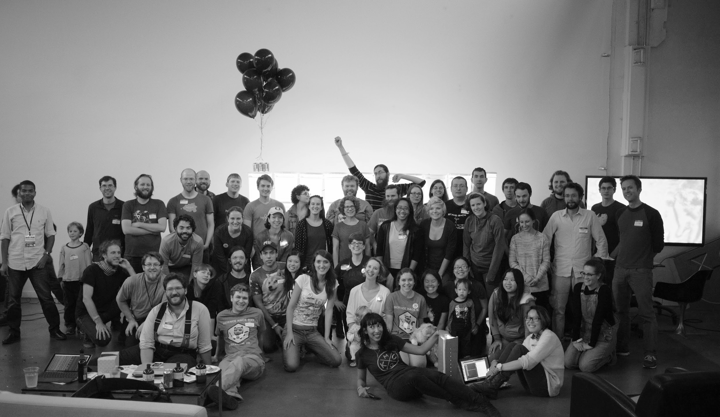

Slide 2
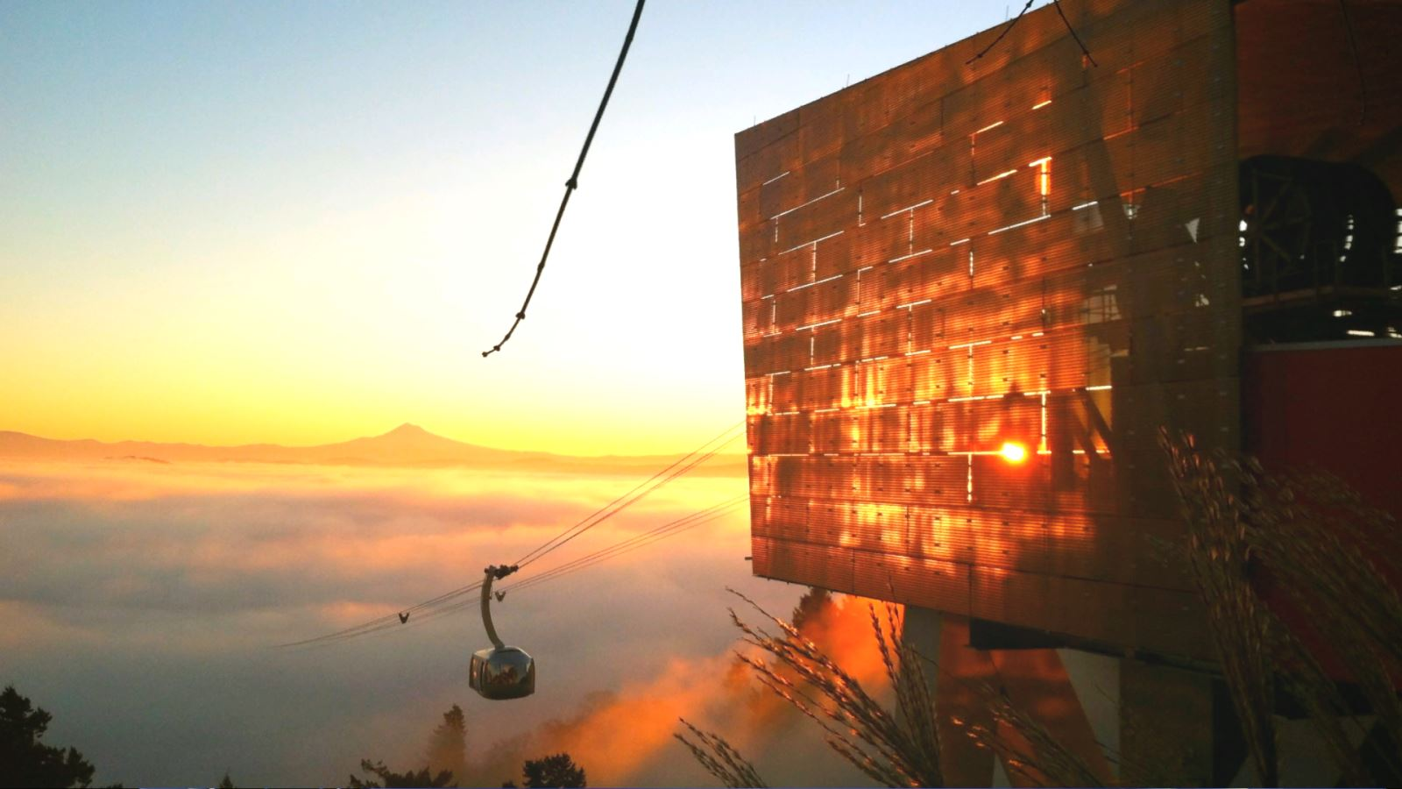

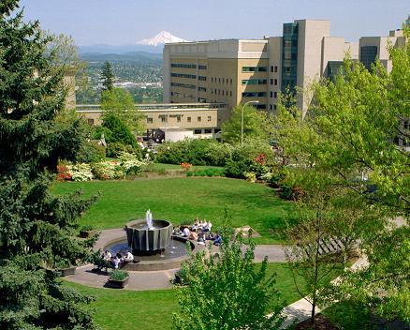
Image credit: http://www.marquamhillcoop.org/

Slide 3
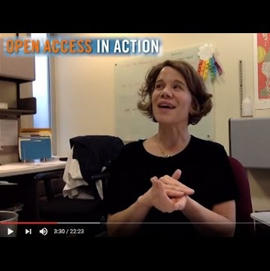
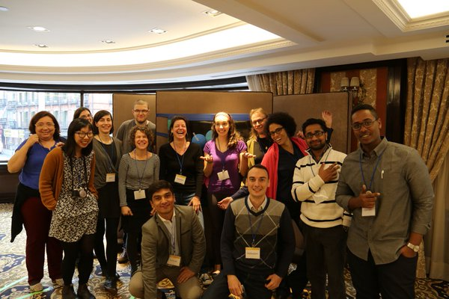


Slide 4
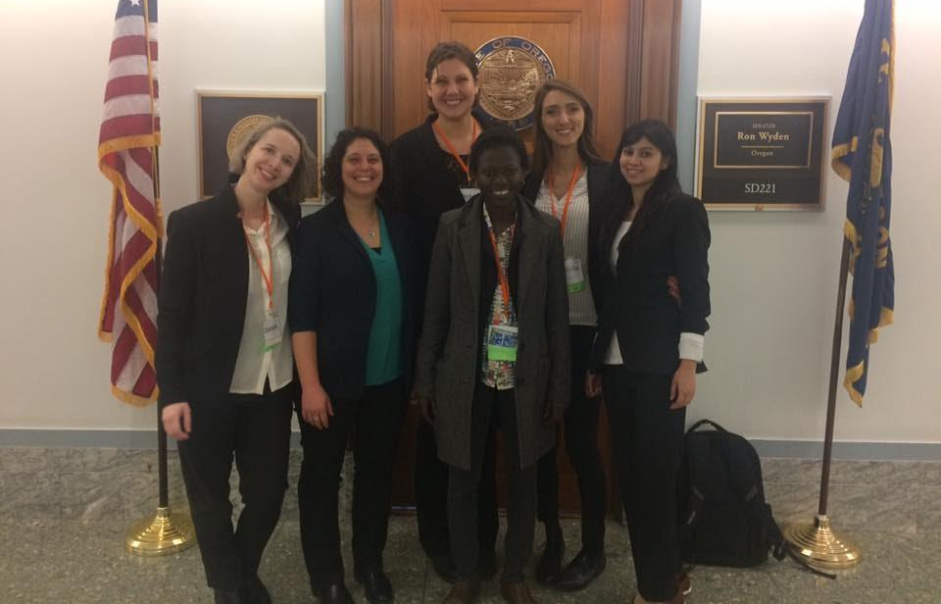
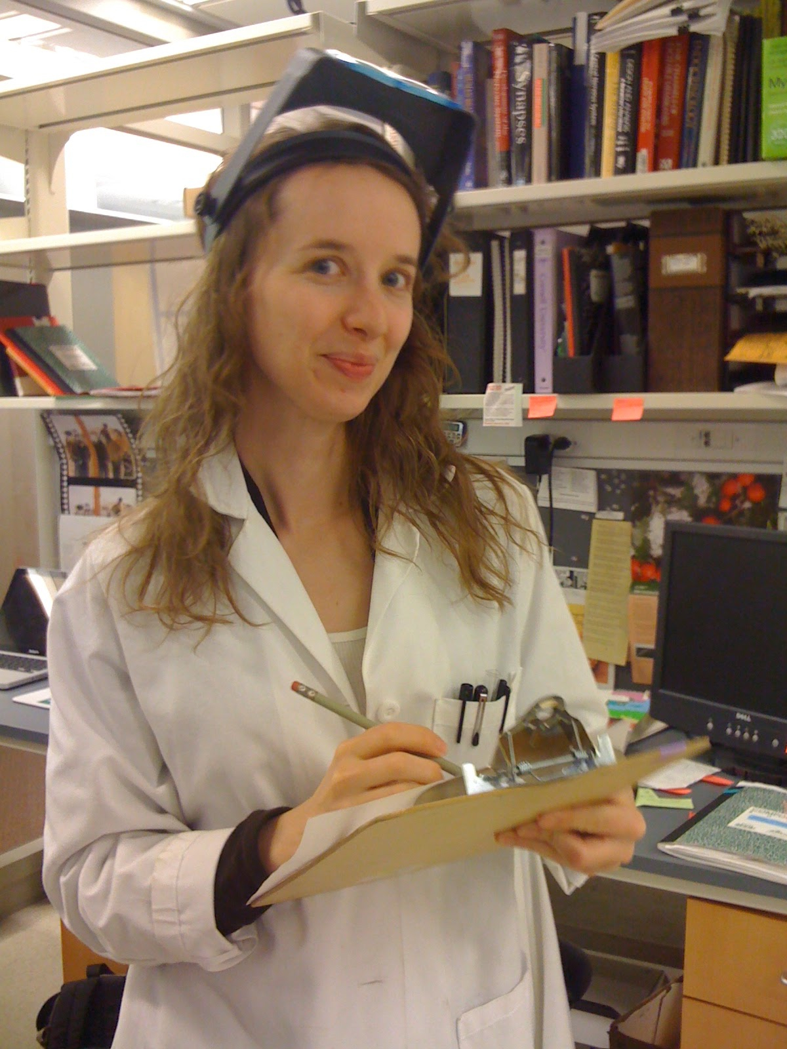


Slide 5



Adapted from: https://www.meetup.com/Berlin-Open-Science-Meetup/
Notes:
https://www.meetup.com/Berlin-Open-Science-Meetup/

Slide 6

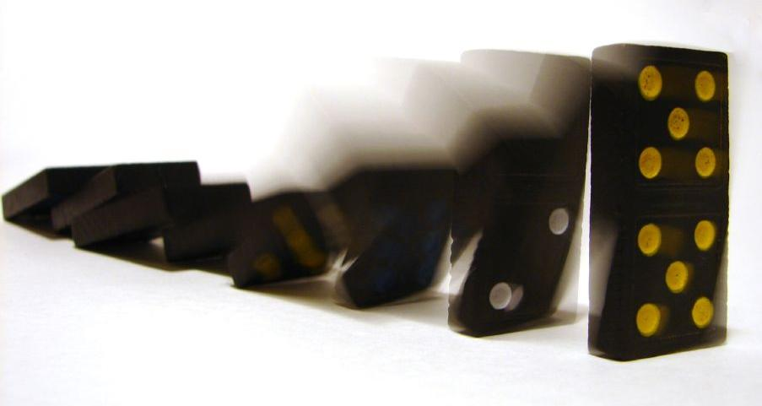

Slide 7
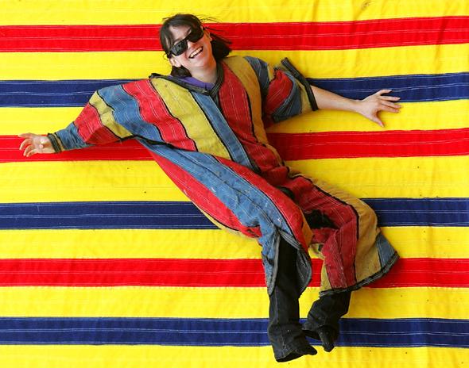

Image: www.partyservicesny.com

Slide 8
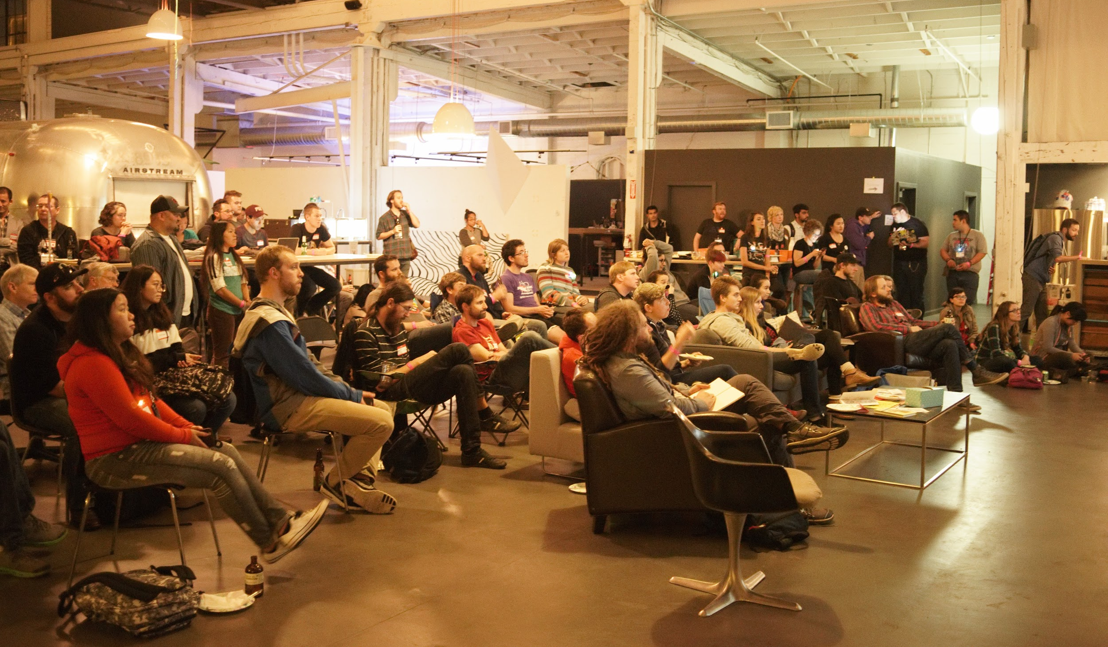

D to R: How have you gained traction with researchers?

Slide 9
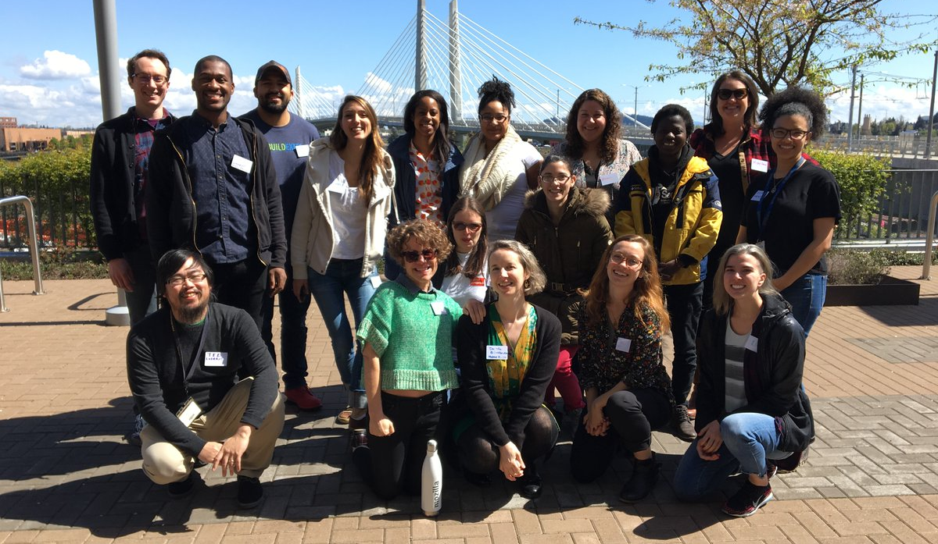


Slide 10


Image credit: Flickr user Raul Lieberwirth

Slide 11
